Slide 1
Data Modeling
Entity-Relationship Model

Slide 2
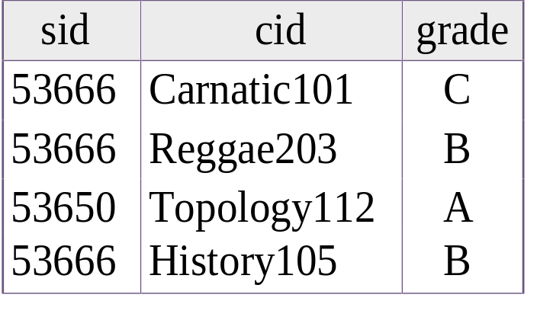
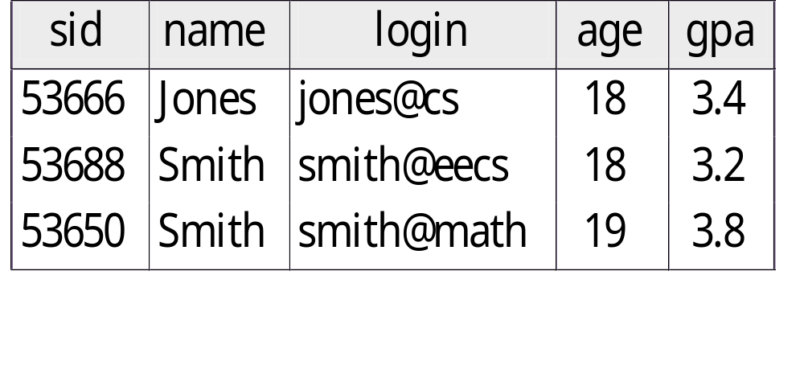
Databases Model the Real World
“Data Model” translates real world things into structures computers can store
Relational
  Rows & Columns
  Keys & Foreign Keys to link Relations
Enrolled
Students

Slide 3
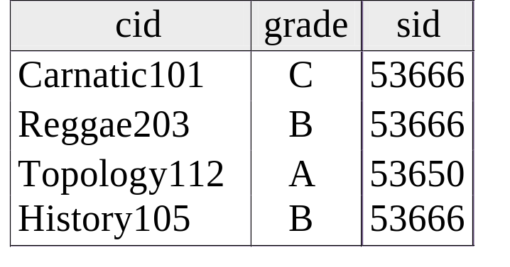
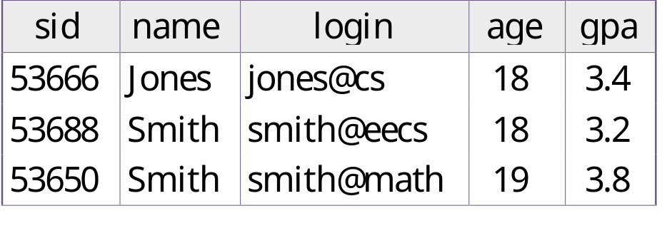
Problems with Relational Model
CREATE TABLE Students
(sid CHAR(20),
name CHAR(20),
login CHAR(10),
age INTEGER,
gpa FLOAT)
CREATE TABLE Enrolled
(sid CHAR(20),
cid CHAR(20),
grade CHAR(2))
With complicated schemas, it may be hard for a person to understand the structure from the data definition.
Enrolled
Students

Slide 4
One Solution: The E-R Model
Instead of relations, it has:
  Entities and Relationships
These are described with diagrams
  both structure, notation more obvious to humans
since
name
dname
ssn
lot
did
budget
Employee
Works_In
Department

Slide 5

The Entity-Relationship Model
Models an enterprise as a collection of entities and relationships
  Entity: a “thing” or “object” in the enterprise that is distinguishable from other objects
    Described by a set of attributes
  Relationship: an association among several entities
Represented diagrammatically by an entity-relationship diagram:

Slide 6
Steps in Database Design
Requirements Analysis
  user needs; what must database do?
Conceptual Design
  high level descr (often done w/ER model)
Logical Design
  translate ER into DBMS data model
Schema Refinement
  consistency, normalization
Physical Design
  indexes, disk layout,clustering
Application and Security Design
  who accesses what, and how

Slide 7
Example: DBA for Bank of America
Requirements Specification
  Determine the requirements of clients ( Database to store information about customers, accounts, loans, branches, transactions, …)
Conceptual Design
  Express client requirements in terms of E/R model.
  Confirm with clients that requirements are correct.
  Specify required data operations
Logical Design
  Convert E/R model to relational, object-based, XML-based,…
Physical Design
  Specify file organizations, build indexes

Slide 8
E-R Modeling
A database can be modeled as:
  a collection of entities,
  relationship among entities.
An entity is an object that exists and is distinguishable from other objects.
  Example: specific person, company, event, plant
Entities have attributes
  Example: people have names and addresses
An entity set is a set of entities of the same type that share the same properties.
  Example: set of all persons, companies, trees, holidays

Slide 9
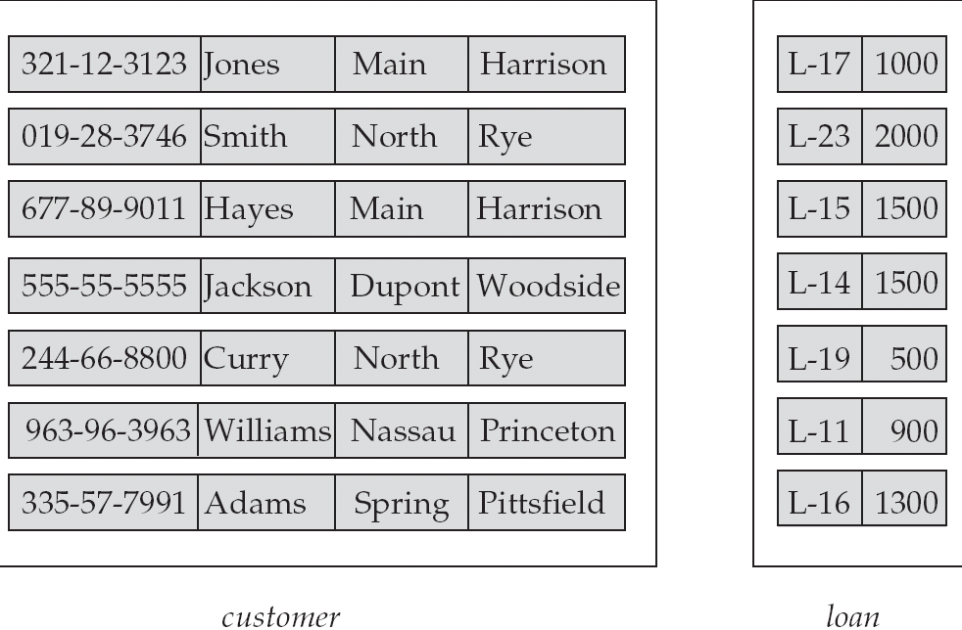
Entity Sets customer and loan
customer_id customer_ customer_ customer_ loan_ amount number
name street city

Slide 10
Relationship Sets
A relationship is an association among several entities
Example:
Hayes depositor A-102
customer entity relationship set account entity
A relationship set is a mathematical relation among n ≥ 2 entities, each taken from entity sets
{(e₁, e₂, … e_{n}) | e₁ ∈ E₁, e₂ ∈ E₂, …, e_{n} ∈ E_{n}}
where (e₁, e₂, …, e_{n}) is a relationship
  Example:
  (Hayes, A-102) ∈ depositor

Slide 11
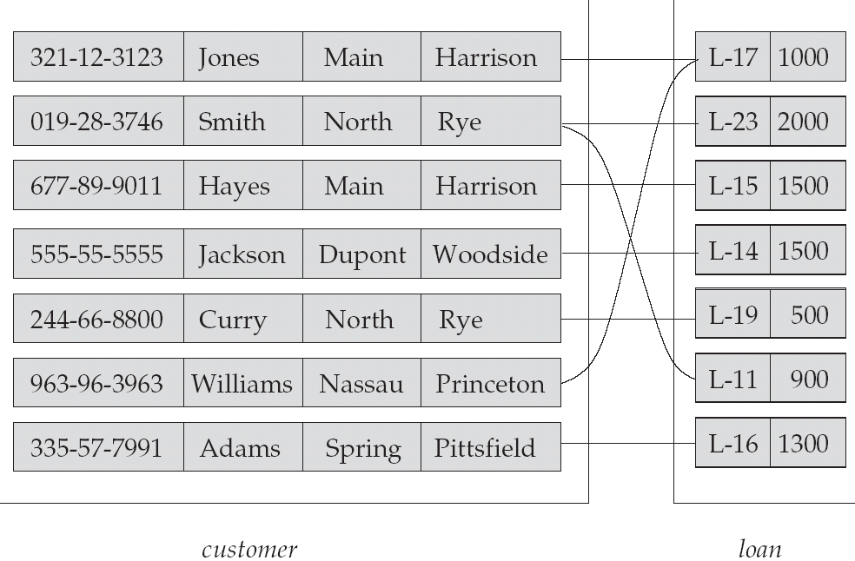
Relationship Set borrower

Slide 12
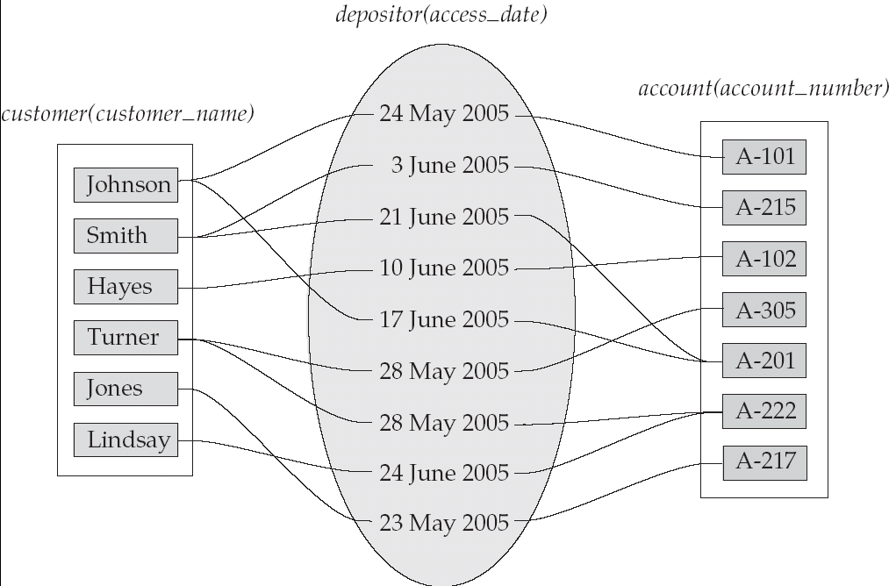
Relationship Sets (Cont.)
An attribute can also be property of a relationship set.
For instance, the depositor relationship set between entity sets customer and account may have the attribute access-date

Slide 13
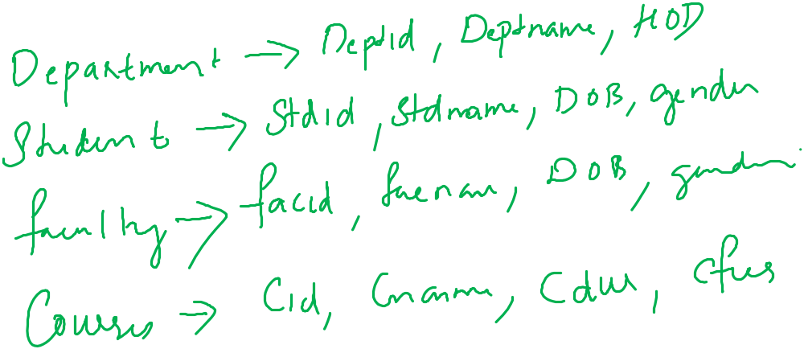

Slide 14
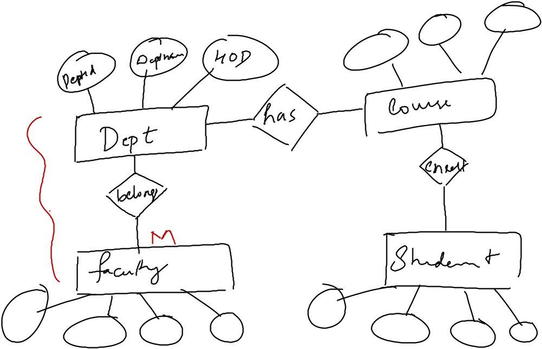
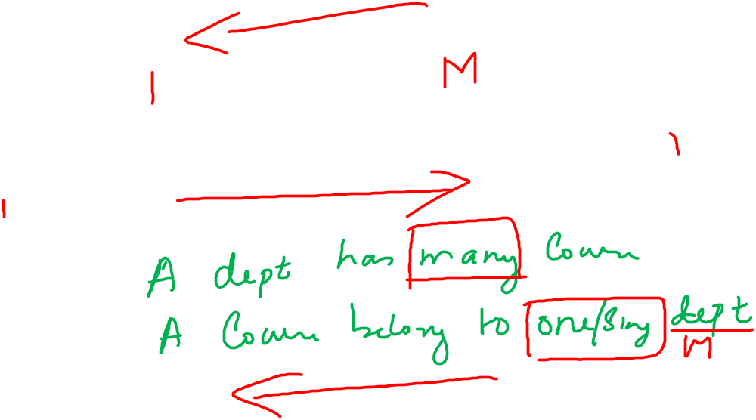



Slide 15

Degree of a Relationship Set
Refers to number of entity sets that participate in a relationship set.
Relationship sets that involve two entity sets are binary (or degree two). Generally, most relationship sets in a database system are binary.
Relationship sets may involve more than two entity sets.
Relationships between more than two entity sets are rare. Most relationships are binary.
  Example: Suppose employees of a bank may have jobs (responsibilities) at multiple branches, with different jobs at different branches. Then there is a ternary relationship set between entity sets employee, job, and branch

Slide 16
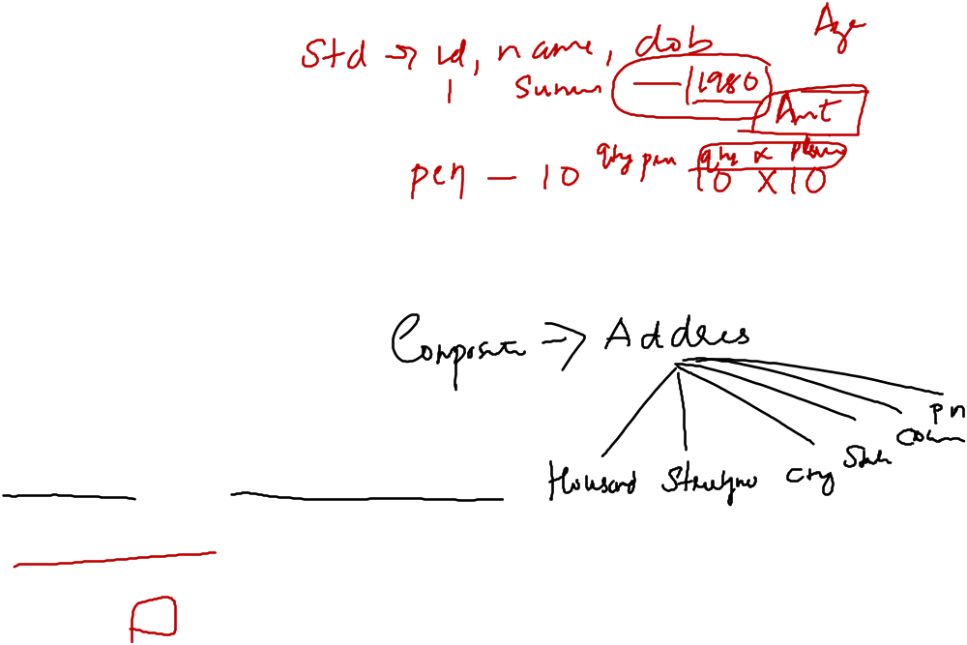
Attributes
An entity is represented by a set of attributes, that is descriptive properties possessed by all members of an entity set.
Domain – the set of permitted values for each attribute
Attribute types:
  Simple and composite attributes.
  Single-valued and multi-valued attributes
    Example: multivalued attribute: phone_numbers
  Derived attributes
    Can be computed from other attributes
    Example: age, given date_of_birth
Example:
customer = (customer_id, customer_name,
customer_street, customer_city )
loan = (loan_number, amount )

Slide 17
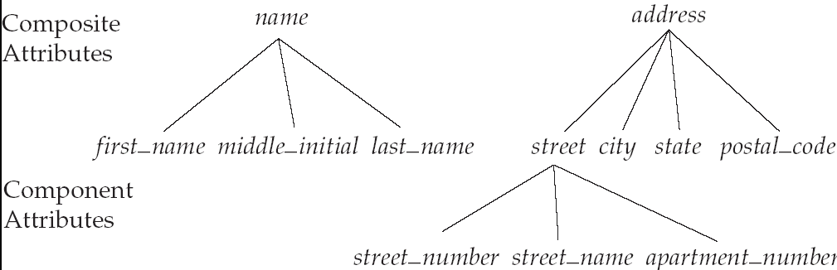
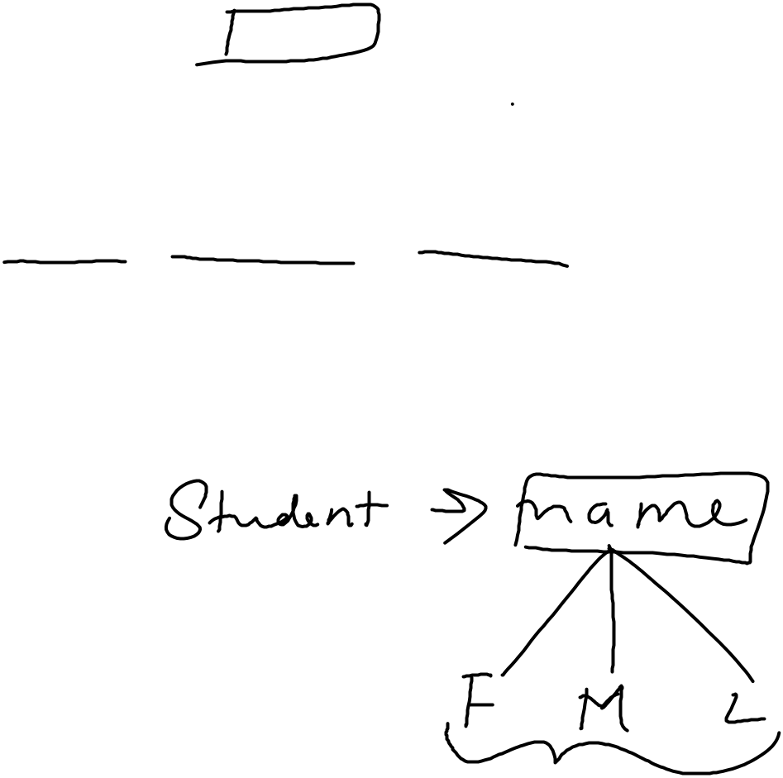
Composite Attributes

Slide 18
Mapping Cardinality Constraints
Express the number of entities to which another entity can be associated via a relationship set.
Most useful in describing binary relationship sets.
For a binary relationship set the mapping cardinality must be one of the following types:
  One to one
  One to many
  Many to one
  Many to many

Slide 19
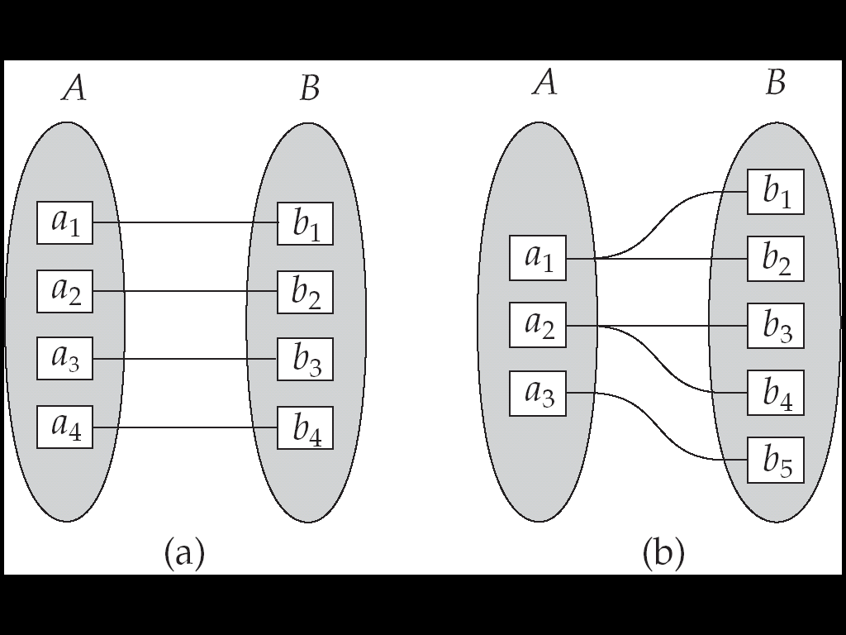
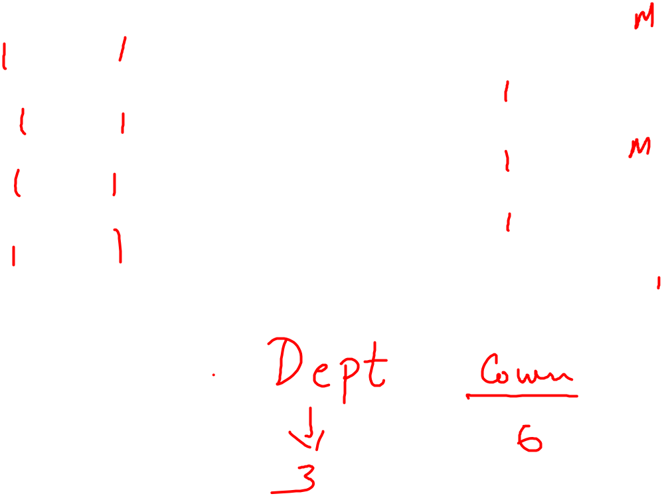
Mapping Cardinalities
One to one
One to many
Note: Some elements in A and B may not be mapped to any
elements in the other set

Slide 20
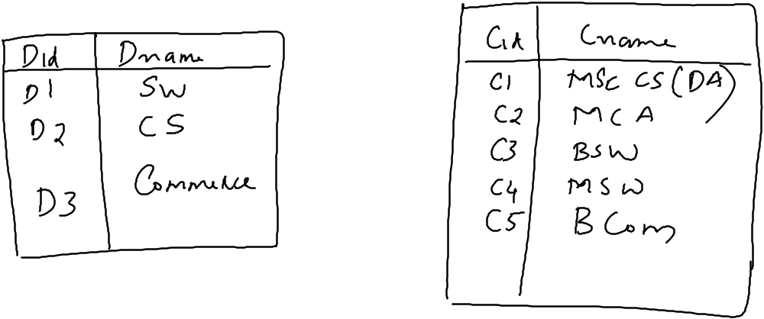
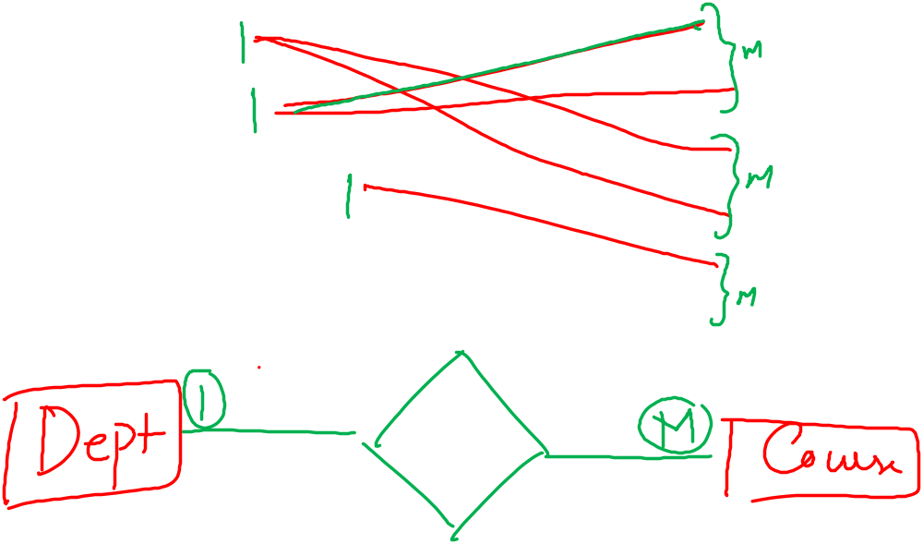

Slide 21
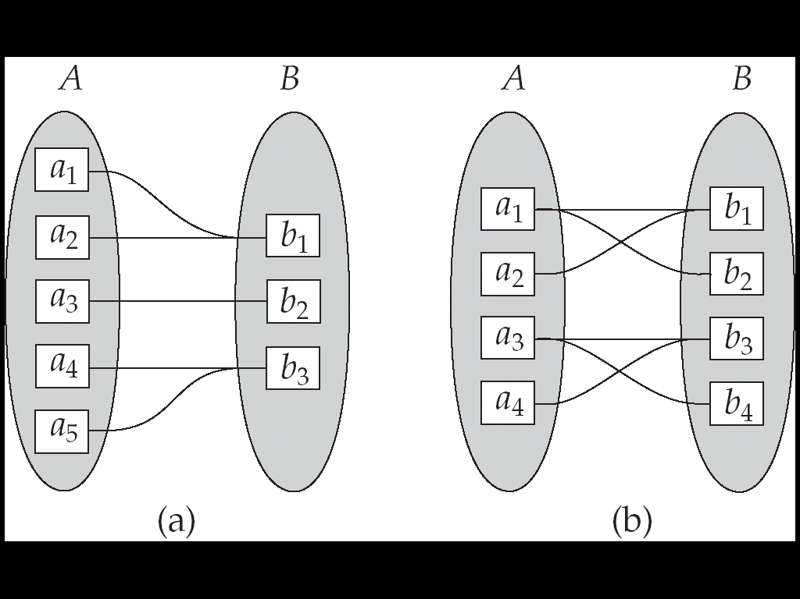
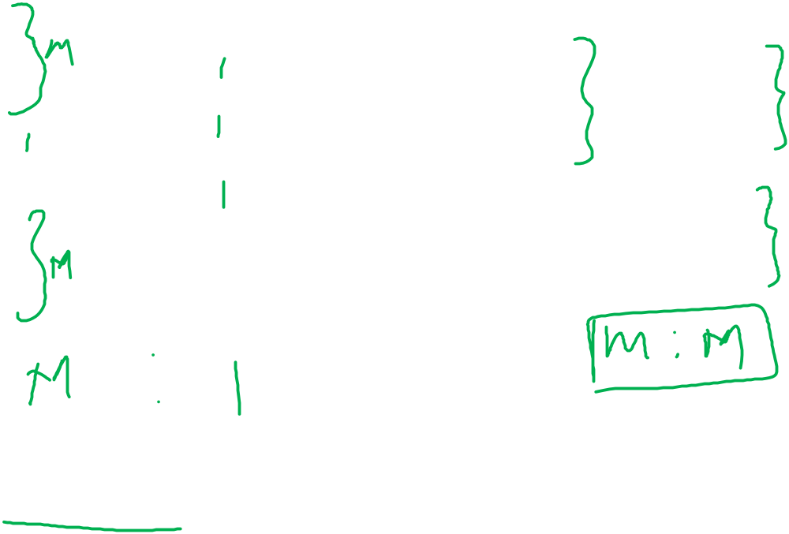
Mapping Cardinalities
Many to one
Many to many
Note: Some elements in A and B may not be mapped to any
elements in the other set

Slide 22
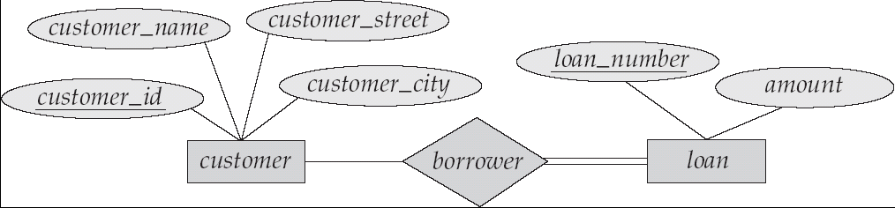
Participation of an Entity Set in a Relationship Set
Total participation (indicated by double line): every entity in the entity set participates in at least one relationship in the relationship set
  E.g. participation of loan in borrower is total
    every loan must have a customer associated to it via borrower
Partial participation: some entities may not participate in any relationship in the relationship set
  Example: participation of customer in borrower is partial

Slide 23
Keys
A super key of an entity set is a set of one or more attributes whose values uniquely determine each entity.
A candidate key of an entity set is a minimal super key
  Customer_id is candidate key of customer
  account_number is candidate key of account
Although several candidate keys may exist, one of the candidate keys is selected to be the primary key.

Slide 24
Keys for Relationship Sets
The combination of primary keys of the participating entity sets forms a super key of a relationship set.
  (customer_id, account_number) is the super key of depositor
  NOTE: this means a pair of entity sets can have at most one relationship in a particular relationship set.
Must consider the mapping cardinality of the relationship set when deciding what are the candidate keys
Need to consider semantics of relationship set in selecting the primary key in case of more than one candidate key

Slide 25
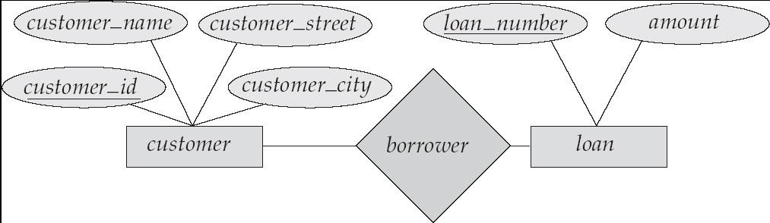
E-R Diagrams
Rectangles represent entity sets.
Diamonds represent relationship sets.
Lines link attributes to entity sets and entity sets to relationship sets.
Ellipses represent attributes
  Double ellipses represent multivalued attributes.
  Dashed ellipses denote derived attributes.
Underline indicates primary key attributes (will study later)

Slide 26
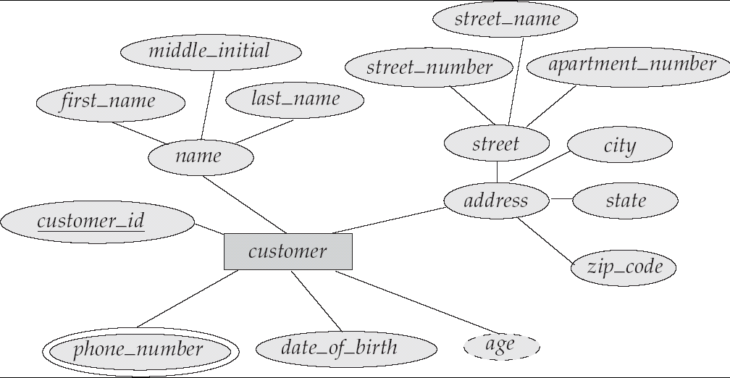
E-R Diagram With Composite, Multivalued, and Derived Attributes

Slide 27
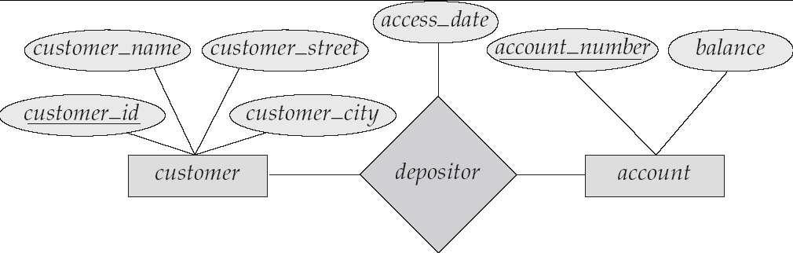
Relationship Sets with Attributes

Slide 28
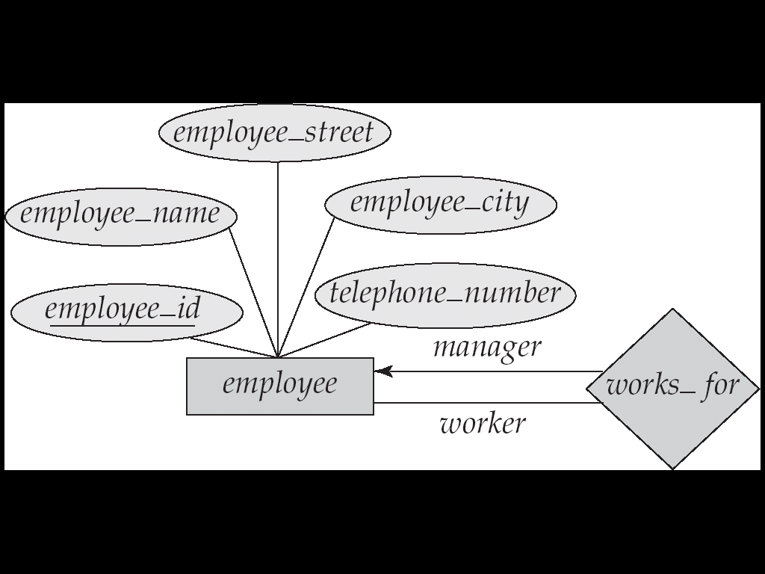

Roles
Entity sets of a relationship need not be distinct
The labels “manager” and “worker” are called roles; they specify how employee entities interact via the works_for relationship set.
Roles are indicated in E-R diagrams by labeling the lines that connect diamonds to rectangles.
Role labels are optional, and are used to clarify semantics of the relationship

Slide 29
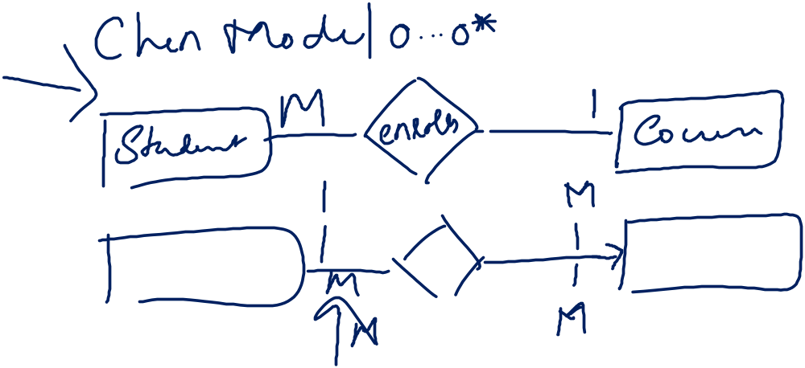
Cardinality Constraints
We express cardinality constraints by drawing either a directed line (→), signifying “one,” or an undirected line (—), signifying “many,” between the relationship set and the entity set.
One-to-one relationship:
  A customer is associated with at most one loan via the relationship borrower
  A loan is associated with at most one customer via borrower

Slide 30


One-To-Many Relationship
In the one-to-many relationship a loan is associated with at most one customer via borrower, a customer is associated with several (including 0) loans via borrower

Slide 31

Many-To-One Relationships
In a many-to-one relationship a loan is associated with several (including 0) customers via borrower, a customer is associated with at most one loan via borrower

Slide 32


Many-To-Many Relationship
A customer is associated with several (possibly 0) loans via borrower
A loan is associated with several (possibly 0) customers via borrower

Slide 33

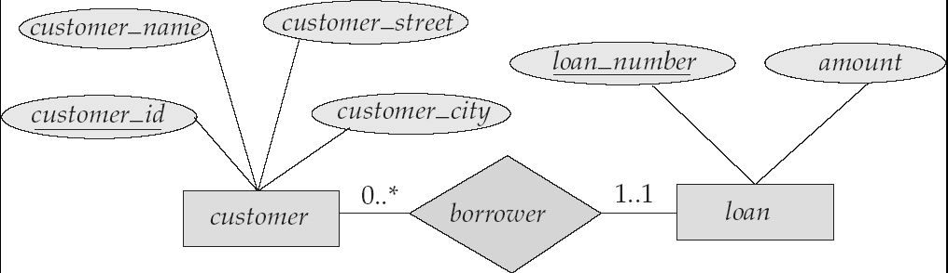
Alternative Notation for Cardinality Limits
Cardinality limits can also express participation constraints

Slide 34
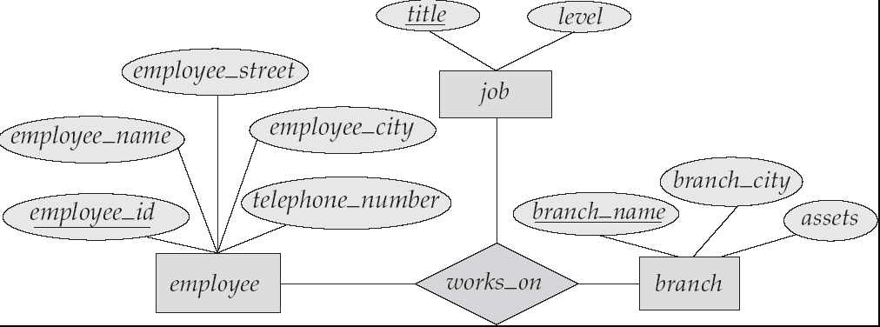
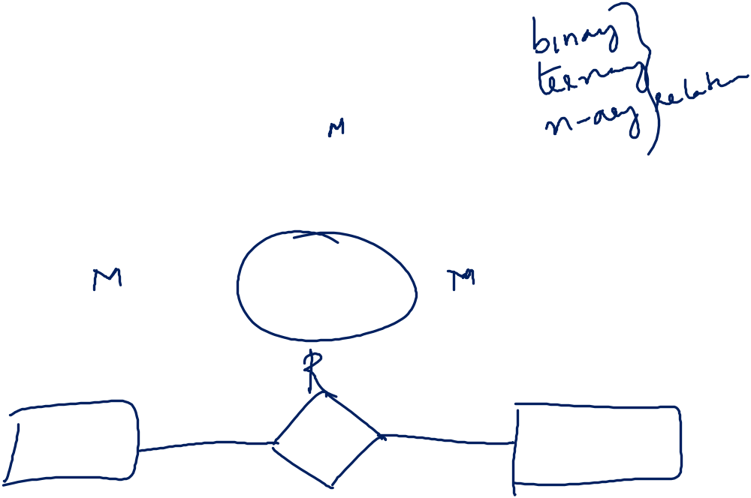
E-R Diagram with a Ternary Relationship

Slide 35
Design Issues
Use of entity sets vs. attributes
Choice mainly depends on the structure of the enterprise being modeled, and on the semantics associated with the attribute in question.
Use of entity sets vs. relationship sets
Possible guideline is to designate a relationship set to describe an action that occurs between entities
Binary versus n-ary relationship sets
Although it is possible to replace any nonbinary (n-ary, for n > 2) relationship set by a number of distinct binary relationship sets, a n-ary relationship set shows more clearly that several entities participate in a single relationship.
Placement of relationship attributes

Slide 36
Binary Vs. Non-Binary Relationships
Some relationships that appear to be non-binary may be better represented using binary relationships
  Example: works_on

Slide 37
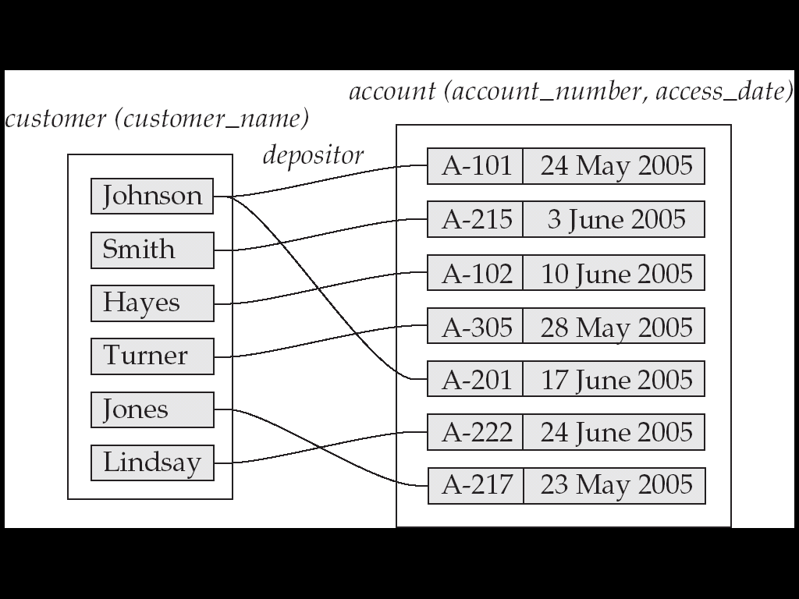
Mapping Cardinalities affect ER Design
Can make access-date an attribute of account, instead of a relationship attribute, if each account can have only one customer
  That is, the relationship from account to customer is many to one, or equivalently, customer to account is one to many

Slide 38
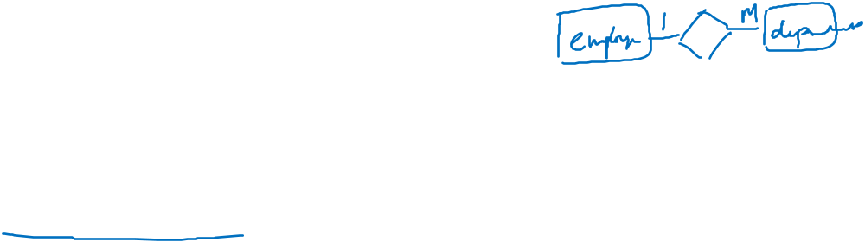
Weak Entity Sets
An entity set that does not have a primary key is referred to as a weak entity set.
The existence of a weak entity set depends on the existence of a identifying entity set
  it must relate to the identifying entity set via a total, one-to-many relationship set from the identifying to the weak entity set
  Identifying relationship depicted using a double diamond
The discriminator (or partial key) of a weak entity set is the set of attributes that distinguishes among all the entities of a weak entity set.
The primary key of a weak entity set is formed by the primary key of the strong entity set on which the weak entity set is existence dependent, plus the weak entity set’s discriminator.

Slide 39
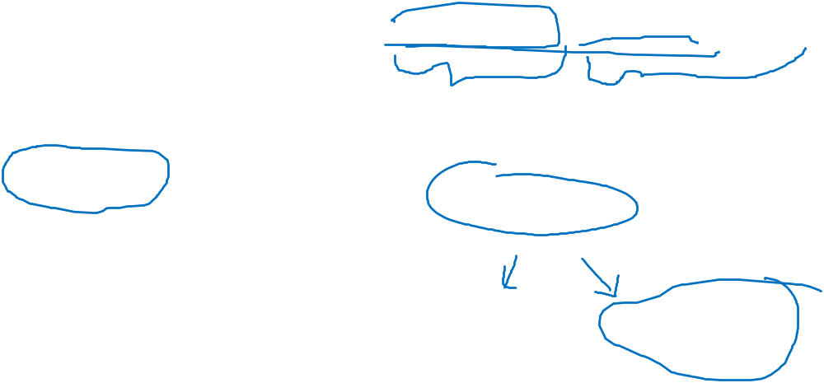
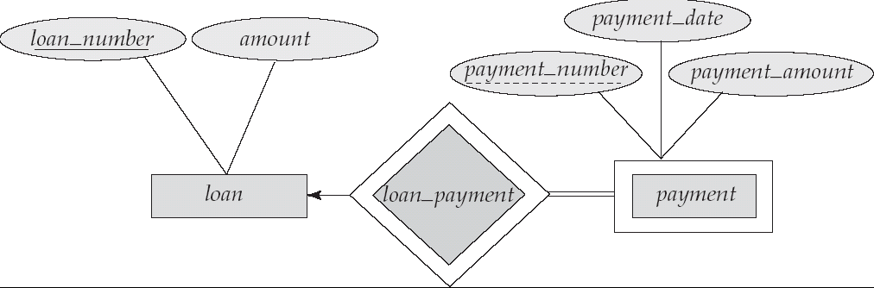
Weak Entity Sets (Cont.)
We depict a weak entity set by double rectangles.
We underline the discriminator of a weak entity set with a dashed line.
payment_number – discriminator of the payment entity set
Primary key for payment – (loan_number, payment_number)

Slide 40
Weak Entity Sets (Cont.)
Note: the primary key of the strong entity set is not explicitly stored with the weak entity set, since it is implicit in the identifying relationship.
If loan_number were explicitly stored, payment could be made a strong entity, but then the relationship between payment and loan would be duplicated by an implicit relationship defined by the attribute loan_number common to payment and loan

Slide 41
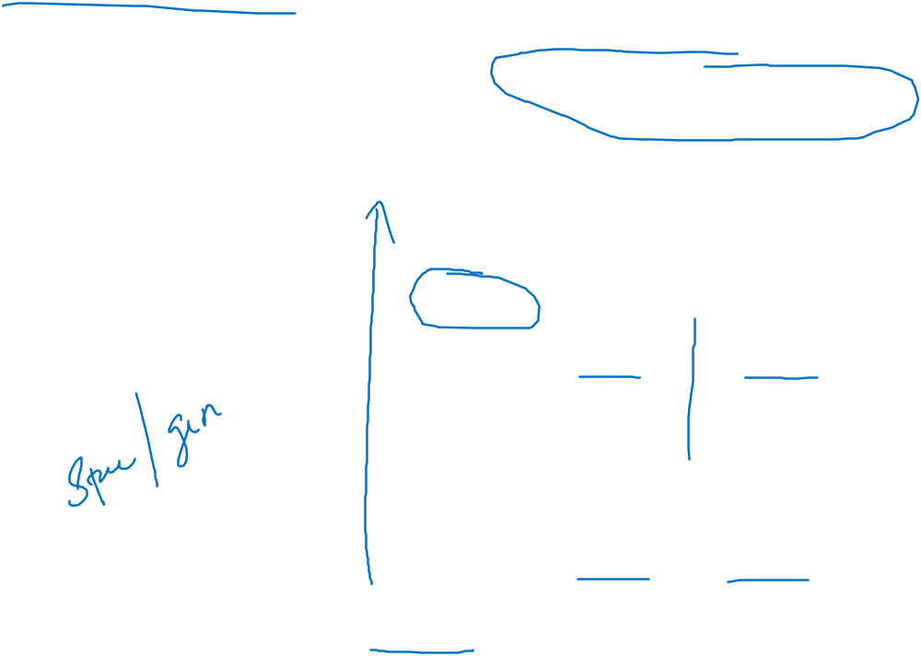
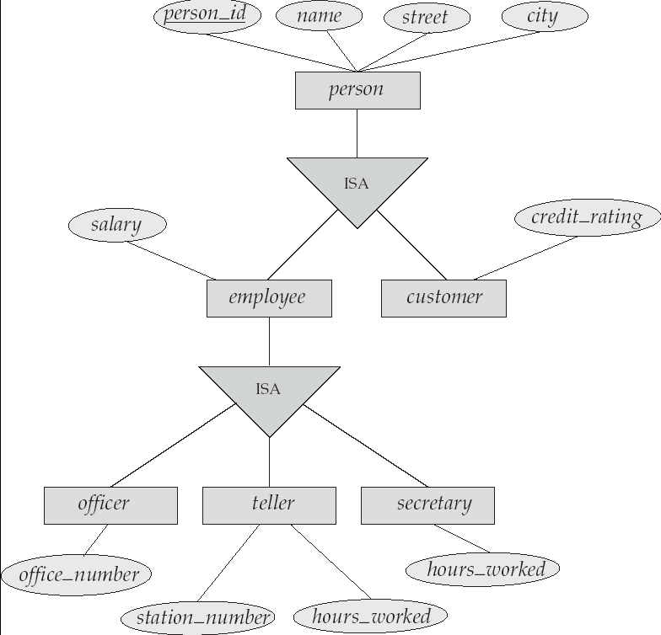
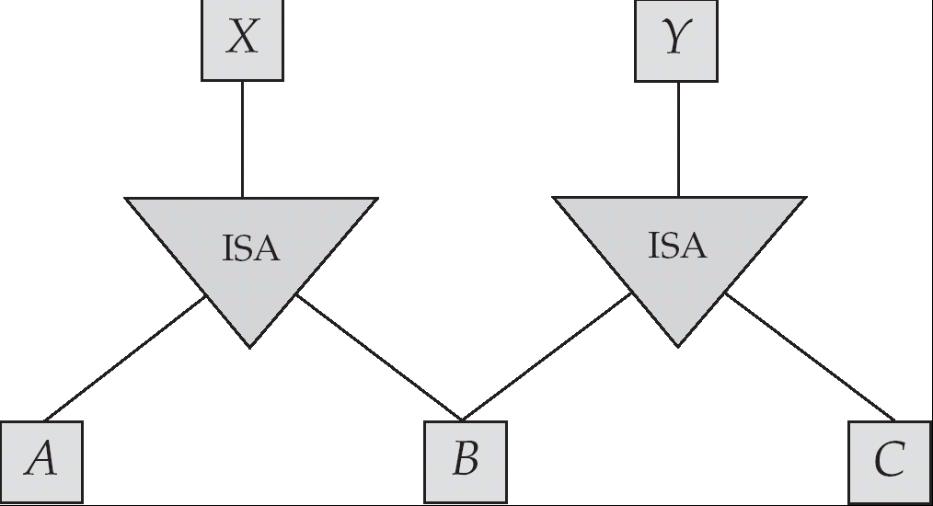
Specialization Example

Slide 42
Extended ER Features: Generalization
A bottom-up design process – combine a number of entity sets that share the same features into a higher-level entity set.
Specialization and generalization are simple inversions of each other; they are represented in an E-R diagram in the same way.
The terms specialization and generalization are used interchangeably.

Slide 43
Specialization and Generalization (Cont.)
Can have multiple specializations of an entity set based on different features.
E.g. permanent_employee vs. temporary_employee, in addition to officer vs. secretary vs. teller
Each particular employee would be
  a member of one of permanent_employee or temporary_employee,
  and also a member of one of officer, secretary, or teller
The ISA relationship also referred to as superclass - subclass relationship

Slide 44
Design Constraints on a Specialization/Generalization
Constraint on which entities can be members of a given lower-level entity set.
  condition-defined
    Example: all customers over 65 years are members of senior-citizen entity set; senior-citizen ISA person.
  user-defined
Constraint on whether or not entities may belong to more than one lower-level entity set within a single generalization.
  Disjoint
    an entity can belong to only one lower-level entity set
    Noted in E-R diagram by writing disjoint next to the ISA triangle
  Overlapping
    an entity can belong to more than one lower-level entity set

Slide 45
Design Constraints on a Specialization/Generalization (Cont.)
Completeness constraint -- specifies whether or not an entity in the higher-level entity set must belong to at least one of the lower-level entity sets within a generalization.
  total : an entity must belong to one of the lower-level entity sets
  partial: an entity need not belong to one of the lower-level entity sets

Slide 46
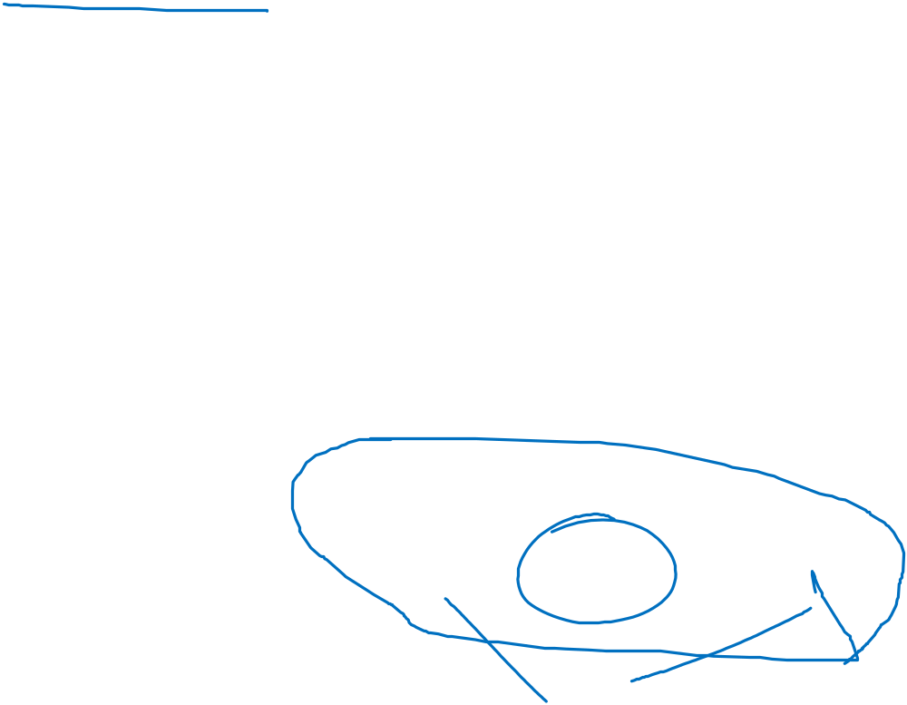
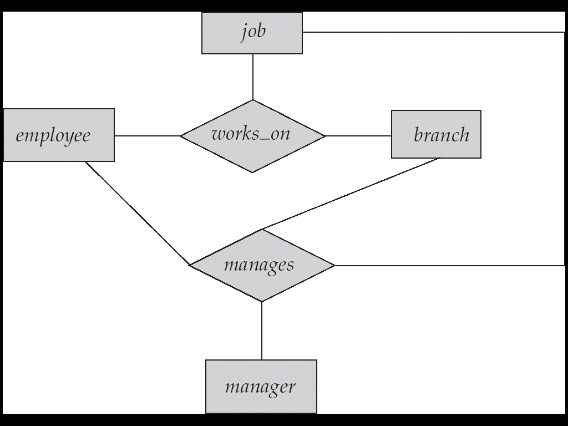
Aggregation
Consider the ternary relationship works_on, which we saw earlier
Suppose we want to record managers for tasks performed by an employee at a branch

Slide 47
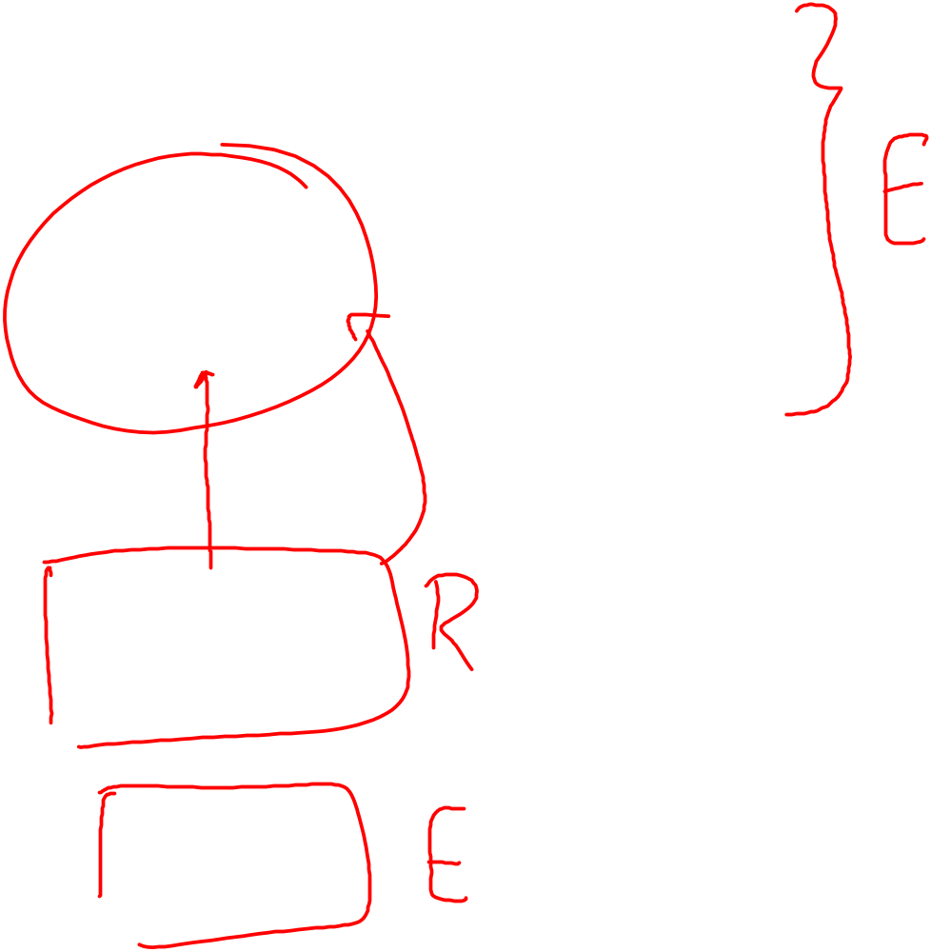
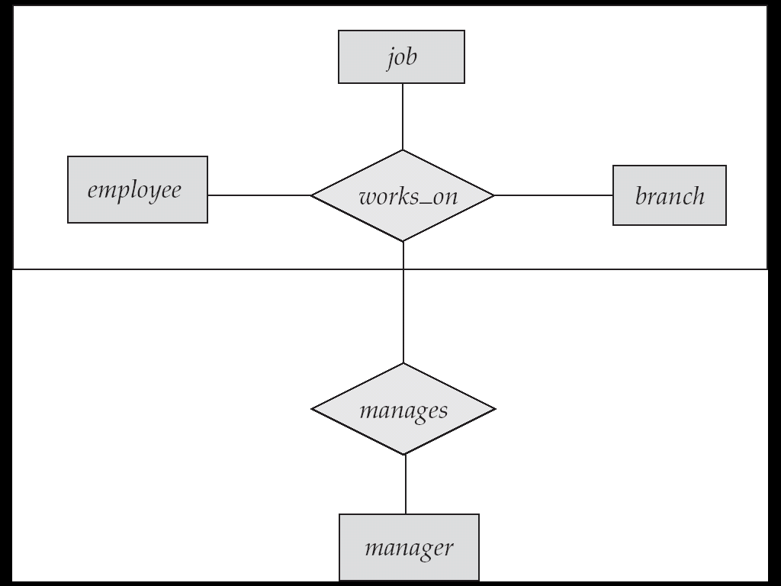
E-R Diagram With Aggregation

Slide 48
E-R Design Decisions
The use of an attribute or entity set to represent an object.
Whether a real-world concept is best expressed by an entity set or a relationship set.
The use of a ternary relationship versus a pair of binary relationships.
The use of a strong or weak entity set.
The use of specialization/generalization – contributes to modularity in the design.
The use of aggregation – can treat the aggregate entity set as a single unit without concern for the details of its internal structure.

Slide 49
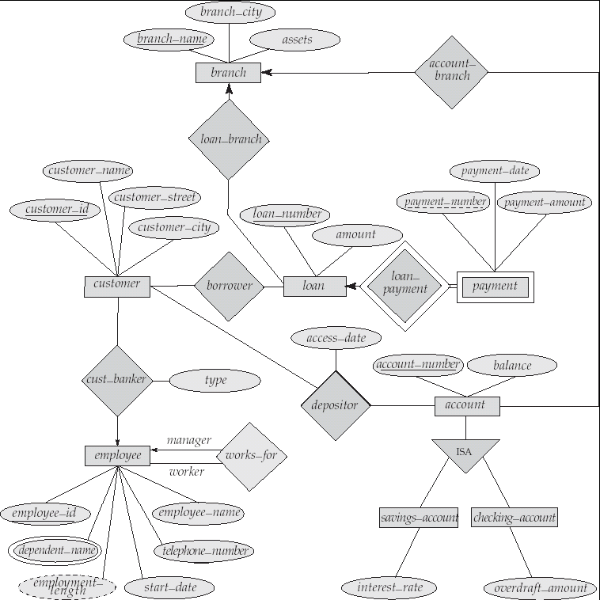

E-R Diagram for a Banking Enterprise

Slide 50
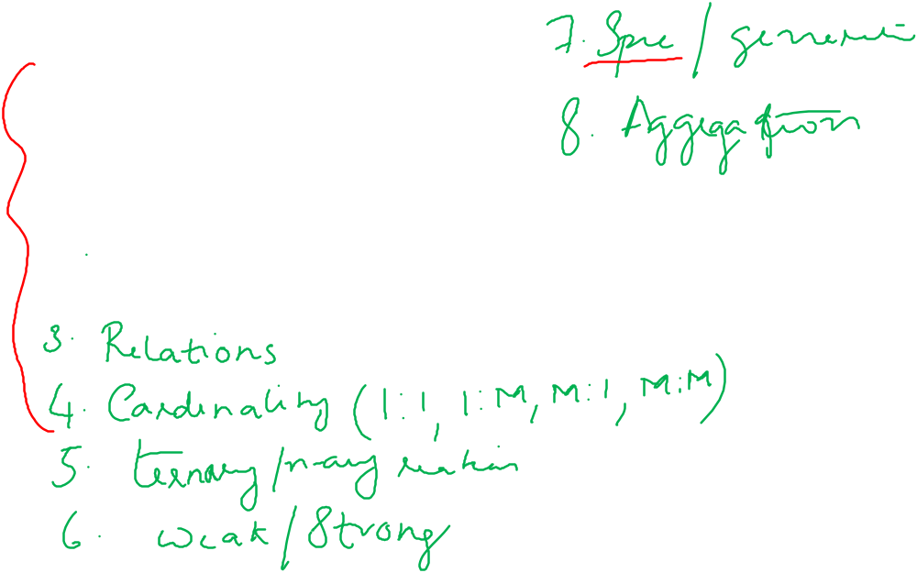
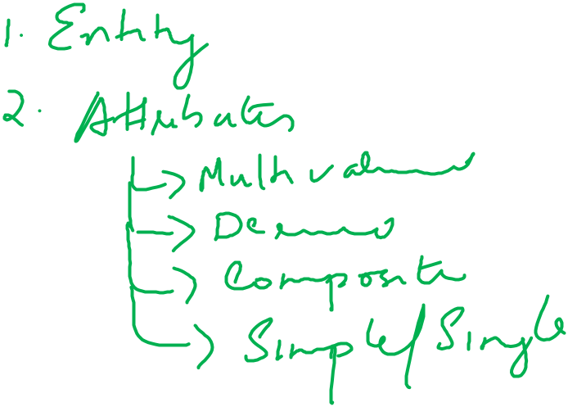

Slide 51
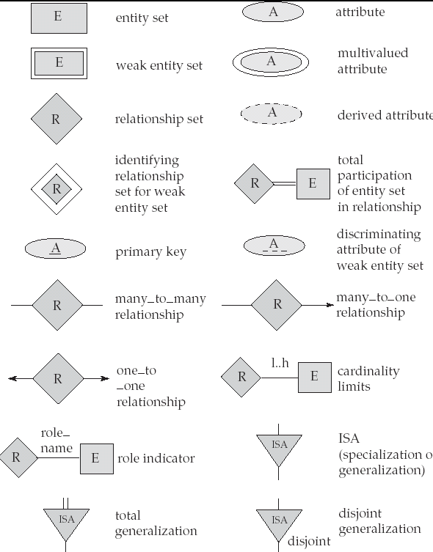
Summary of Symbols Used in E-R Notation

Slide 52

Summary of Symbols (Cont.)

Slide 53
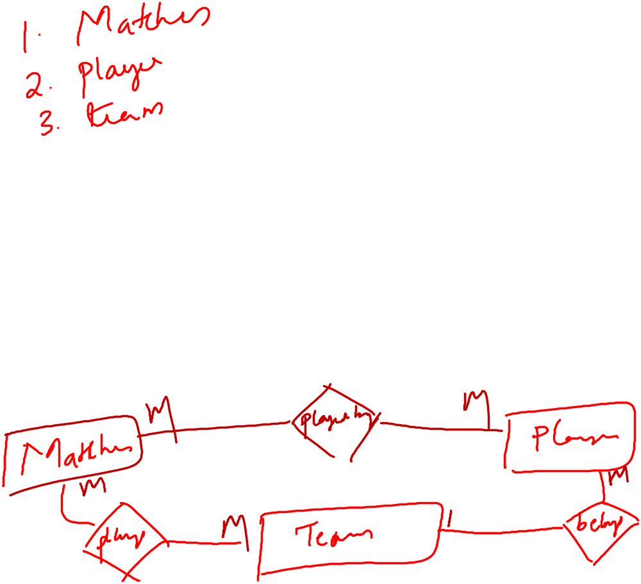
Exercise
Design an E-R diagram for keeping track of the exploits of your favourite sports team. You should store the matches played, the scores in each match, the players in each match and individual player statistics for each match. Summary statistics should be modeled as derived attributes.

Slide 54
